Slide 1
Assignment 2
Oct. 24, 2024

Slide 2
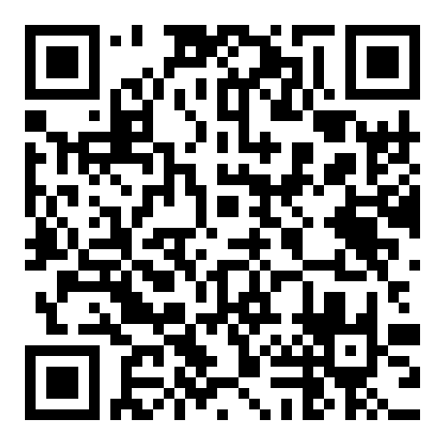
https://www.cs.nycu.edu.tw/~lhyen/np/ass2/np24f_ass2p.html
Local Testing Servers:
140.113.235.237
Final Testing Server:
140.113.207.75

